Slide 1
Single-neuron representations of odours in the human brain
Kehl et al. 2024
Nature Vol. 634

Slide 2
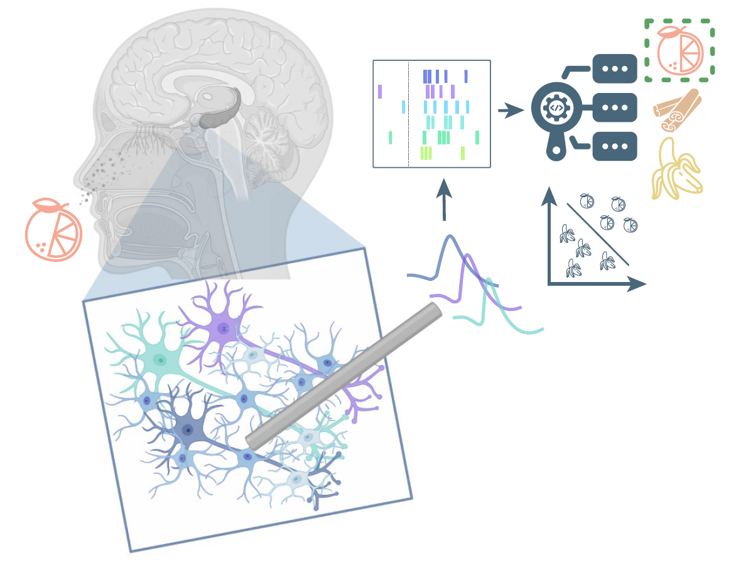
Study
Electrophysiology in awake humans.
Epilepsy patients
n = 17 (12f, 22-60yrs)

Slide 3
Study
27 sessions
2,416 neurons

Slide 4
Abstract
Observed odor-modulated neurons in
Piriform cortex
Amygdala
Entorhinal cortex
Hippocampus

Slide 5
Abstract
Observed neurons that respond to semantically-coherent odor and image information.

Slide 6
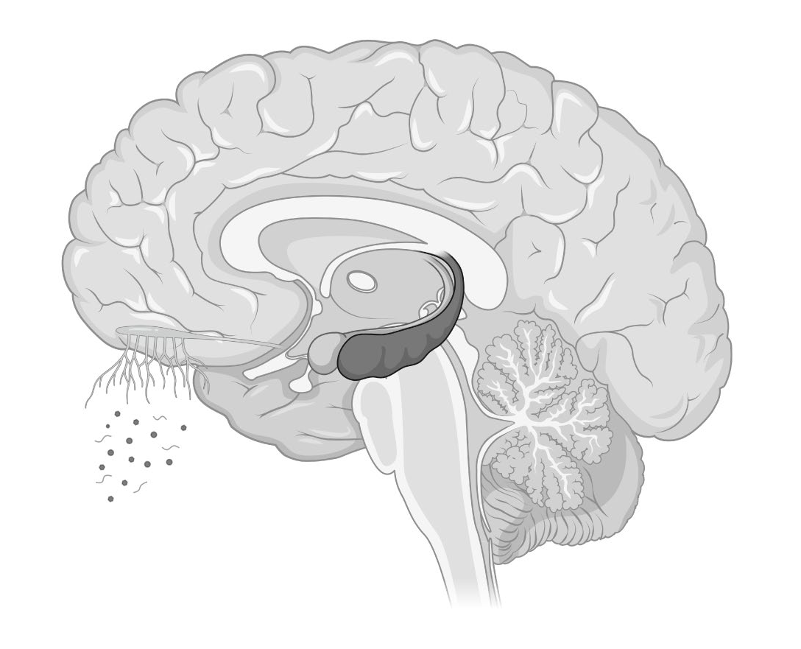
Olfactory Network
Smell
Taste
Navigation

Slide 7
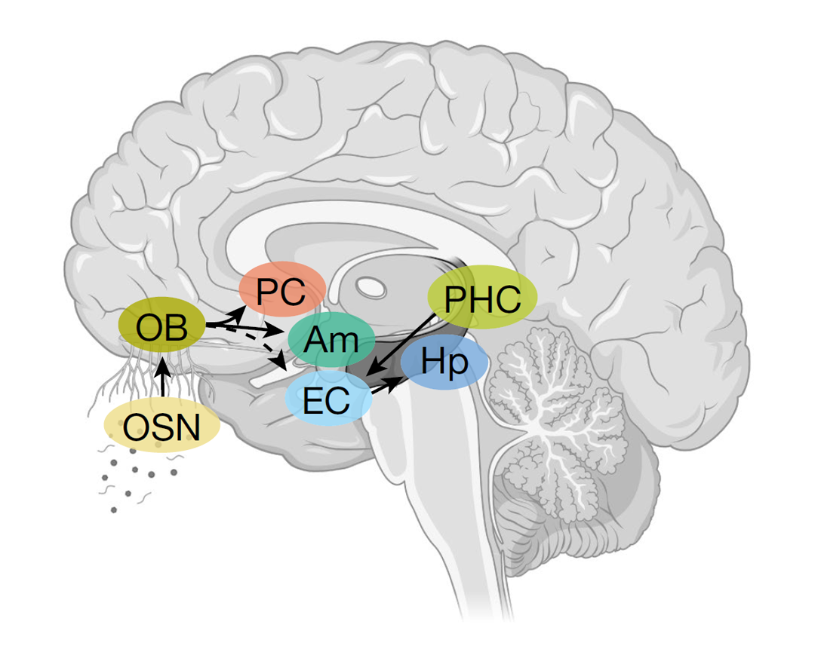
Olfactory Network
Odor Sensory Neurons (OSN)
Olfactory Bulb (OB)
Piriform Cortex (PC)
Amygdala (Am)
Entorhinal Cortex (EC)
Hippocampus (Hp)
Parahippocampal Cortex (PHC)

Slide 8
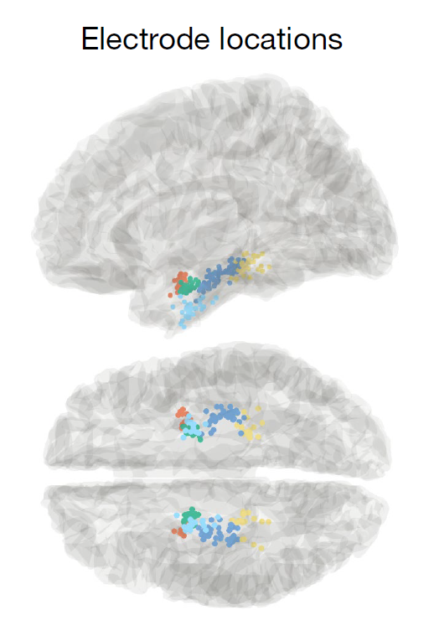
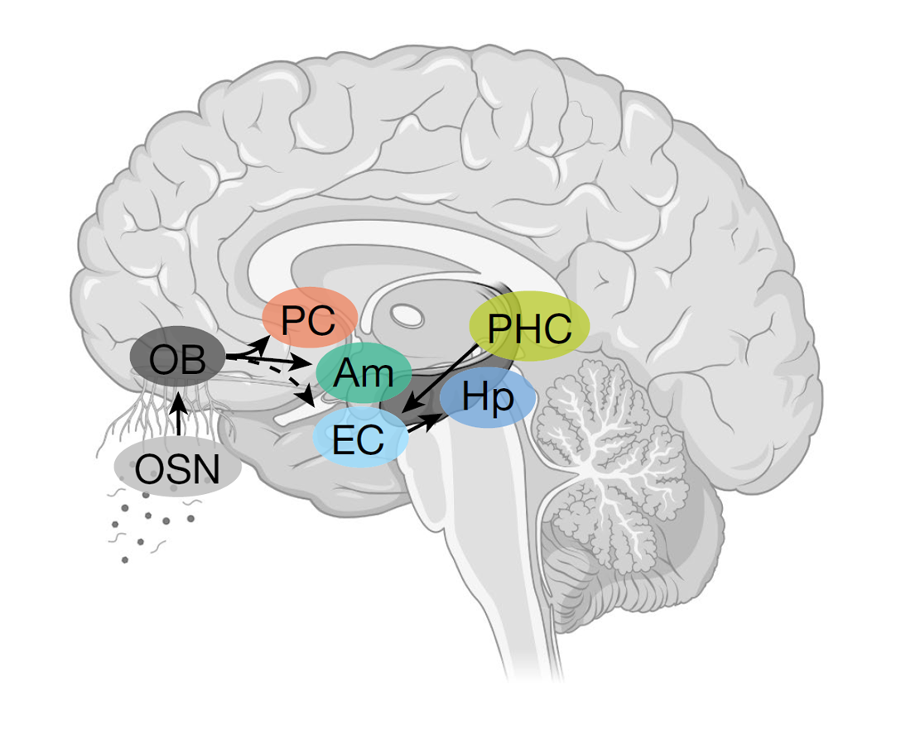

Slide 9
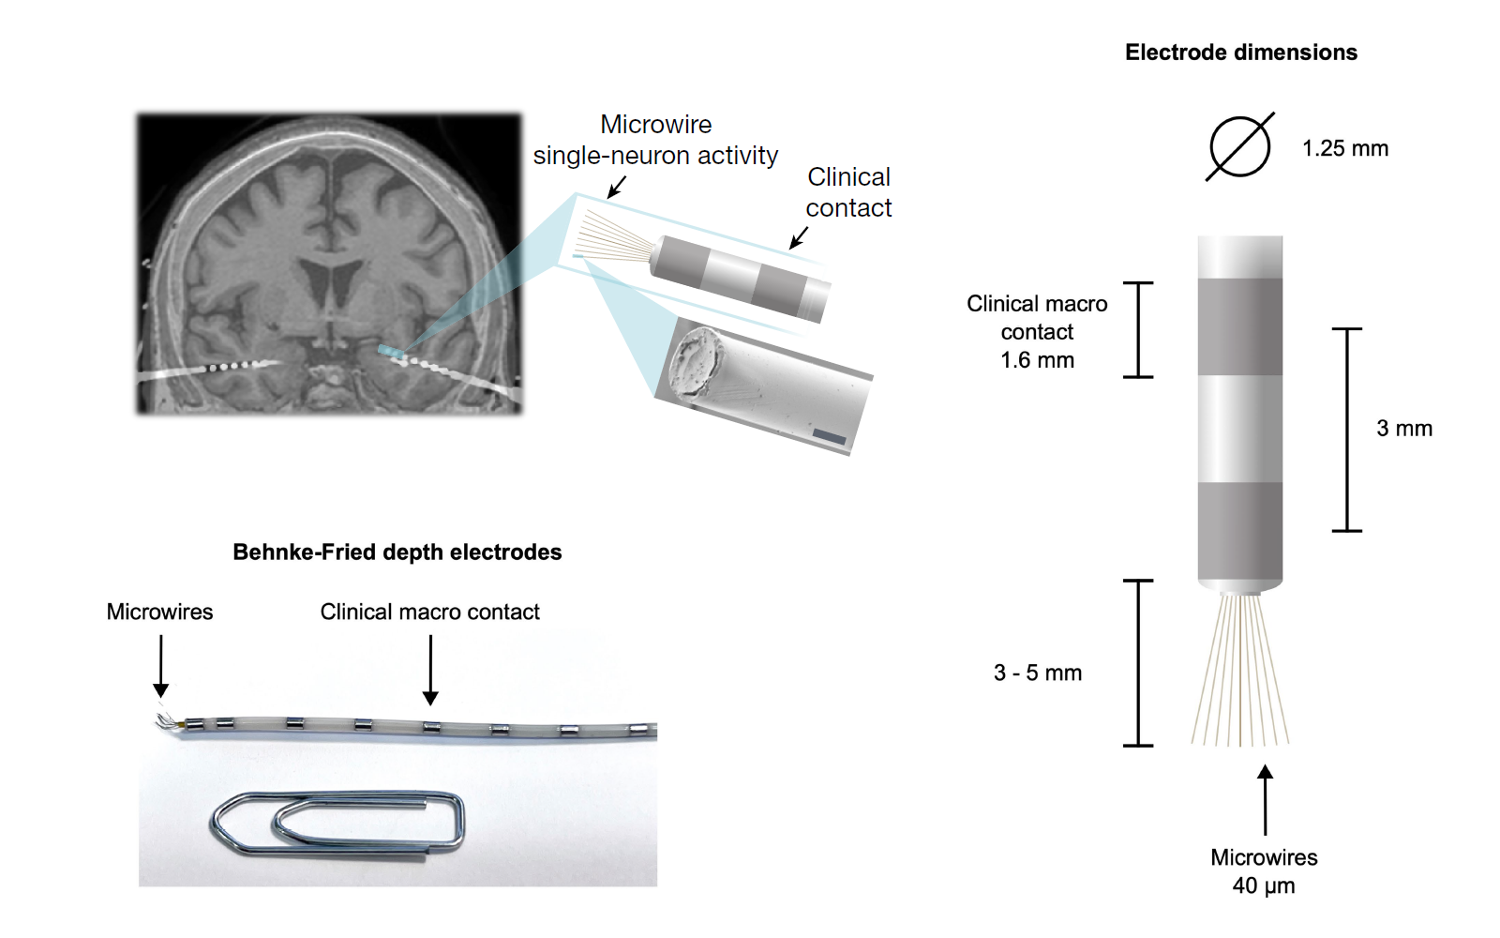

Slide 10
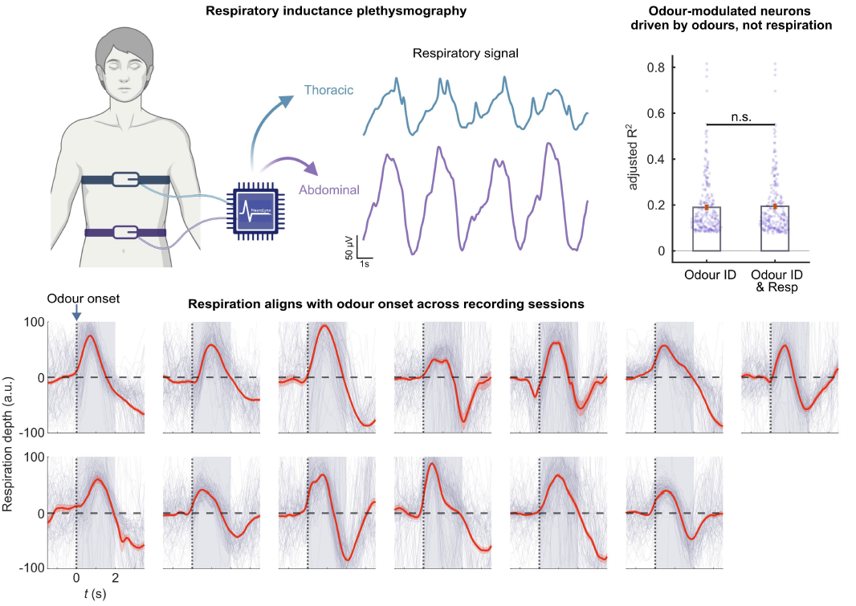
Notes:
b, Performance (adjusted R2) of linear regression models, predicting neuronal
firing (z-scores) based on odour identity, or odour identity combined with
respiration (inhalation depth). Adding respiratory information to odour identity
did not significantly improve the model predictions of firing rates of odourmodulated
Neurons
c, Averaged odour-locked
respiratory signals for each individual recording session (mean ― s.e.m.,
13 sessions with

Slide 11
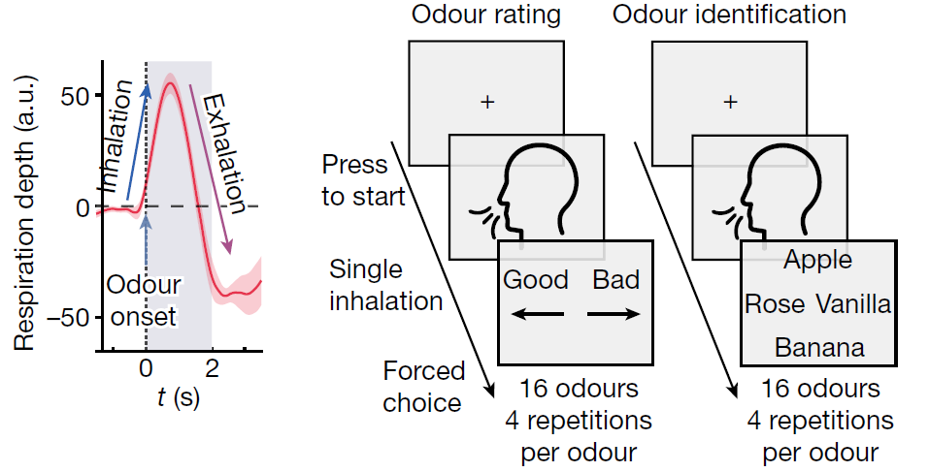
Tasks

Slide 12
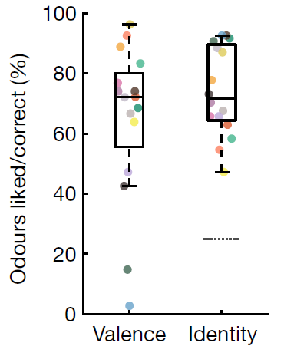
Tasks
Notes:
The behavioural
performance per odour, showing ratings (left) and correct identification (right).
n = 27 sessions. The box plots show the median values (centre lines), 25th–75th
percentiles (box limits), and the whiskers span data within 1.5× the interquartile
range. Statistical analysis of odour identification was performed using twosided
Wilcoxon signed-rank tests versus chance (25%; dashed line);

Slide 13
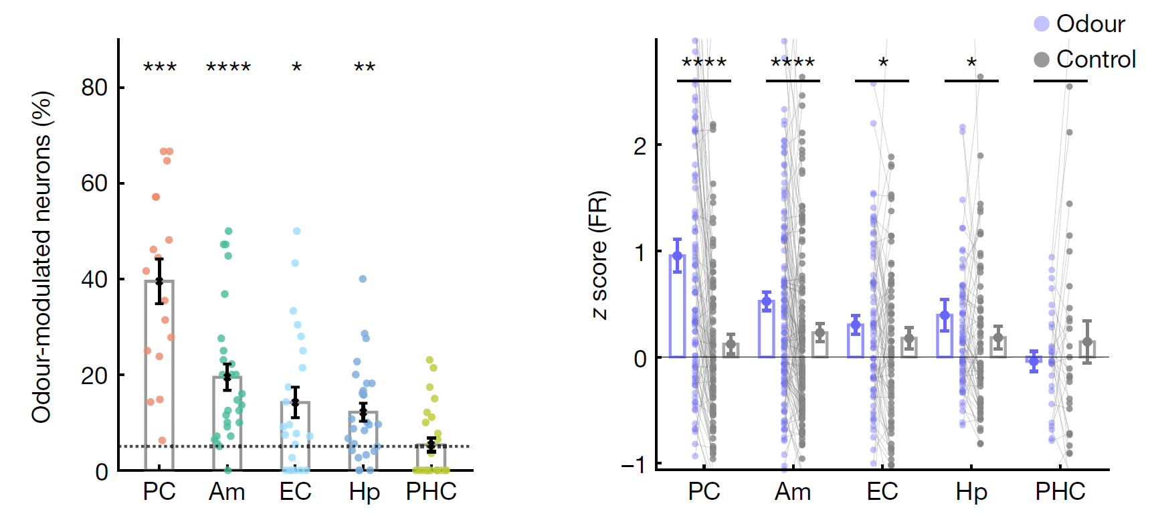
Odors modulate PC and MTL firing
Notes:
Odour-modulated
neurons per session and region (mean ― s.e.m.). The PC, amygdala, EC and
hippocampus host significant populations of odour-modulated neurons
(PC, 39.5 ―

Slide 14
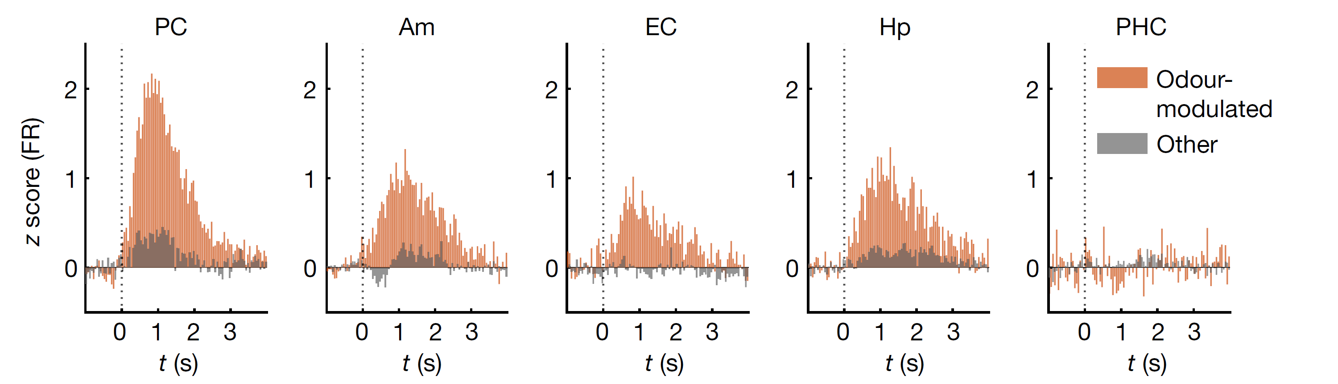
Odors modulate PC and MTL firing

Slide 15
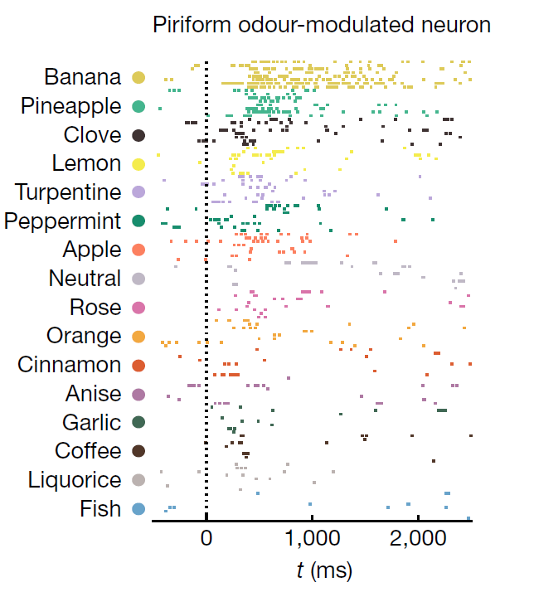

Neuronal activity decodes odor identity

Slide 16
Neuronal activity decodes odor identity
Notes:
b, The odour-identity decoding accuracy per region. Each red
dot shows the decoding performance based on 200 randomly drawn neurons
(1,000 subsampling runs).
The decoding performance (mean ― s.e.m.) across
subsampling runs is shown in black. The grey dots indicate the decoding
performance on label-permuted data.

Slide 17
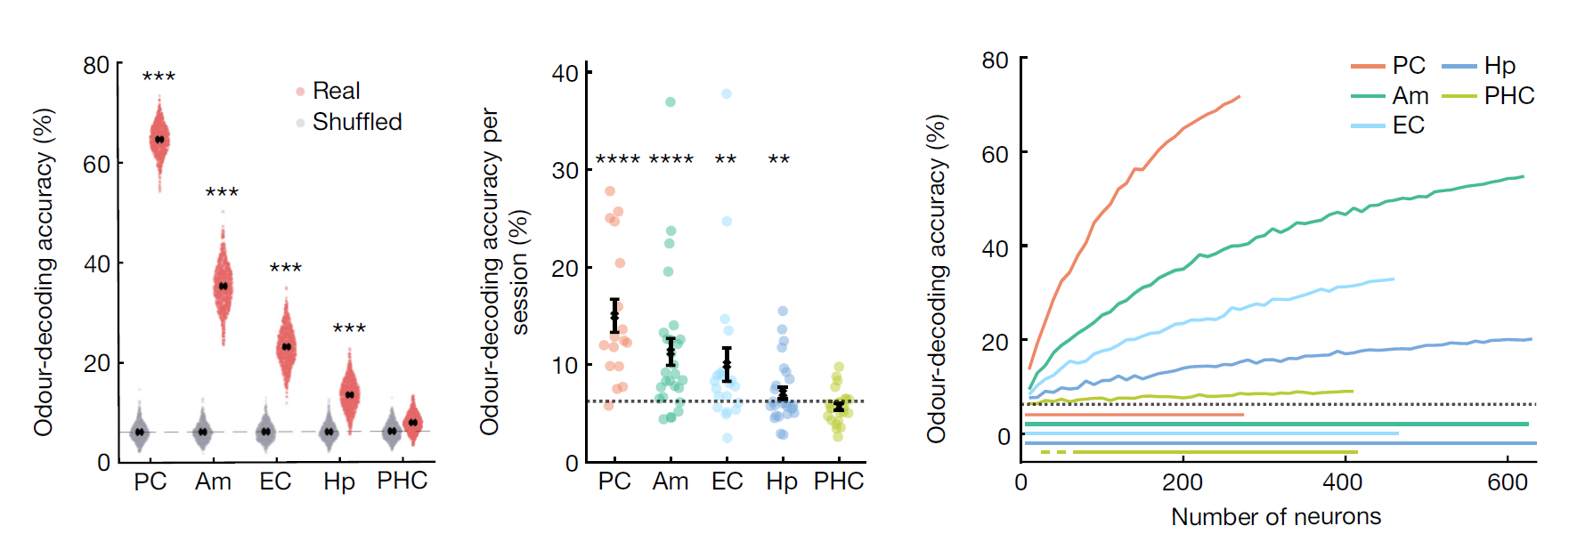
Neuronal activity decodes odor identity
Notes:
b, The odour-identity decoding accuracy per region. Each red
dot shows the decoding performance based on 200 randomly drawn neurons
(1,000 subsampling runs).
The decoding performance (mean ― s.e.m.) across
subsampling runs is shown in black. The grey dots indicate the decoding
performance on label-permuted data.
e, The odour decoding performance (mean ― s.e.m., black) per recording
session and region (coloured dots). Despite the limited and variable neuron
counts per session, odour identity could be decoded significantly above
chance (6.25%, dashed line) in the PC, amygdala, EC and hippocampus

Slide 18
Neuronal activity decodes odor identity
Piriform cortex is especially accurate.
Notes:
Next we’ll look at what other regions are specialized in.

Slide 19
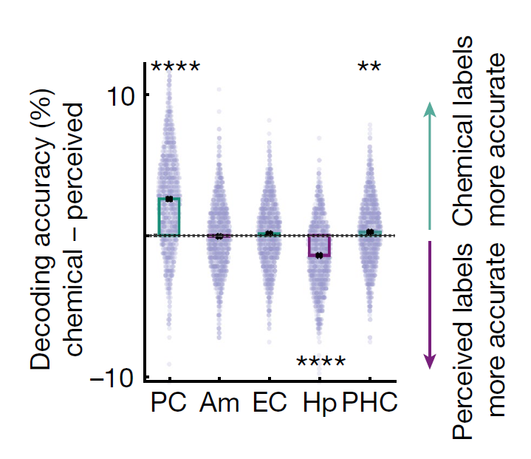
Notes:
Hp predicted behavioral odor identification performance.
Other regions did not.

Slide 20
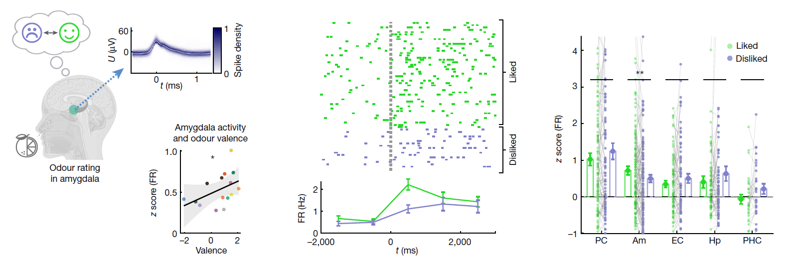
Amygdala predicts valenced responses
Single amygdala neuron
Notes:
Hp predicted behavioral odor identification performance.
Other regions did not.

Slide 21
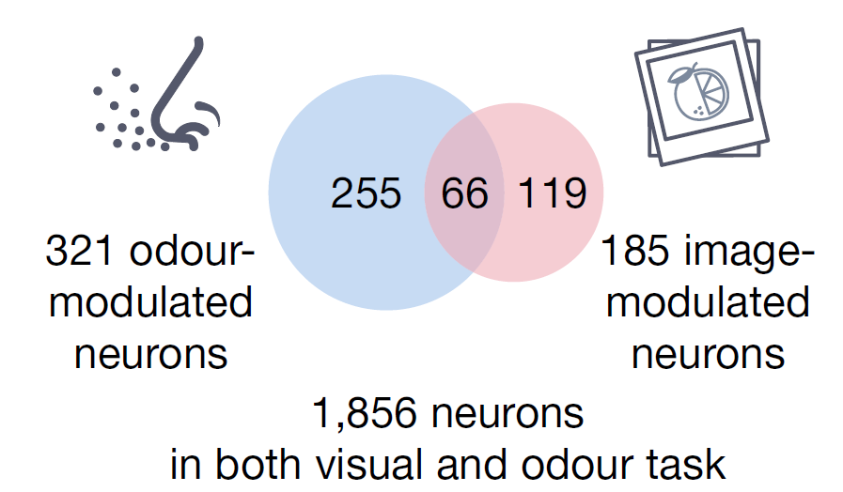
Multimodal odor-modulated cells
Neurons that respond to semantically-coherent odor/image inputs.

Slide 22
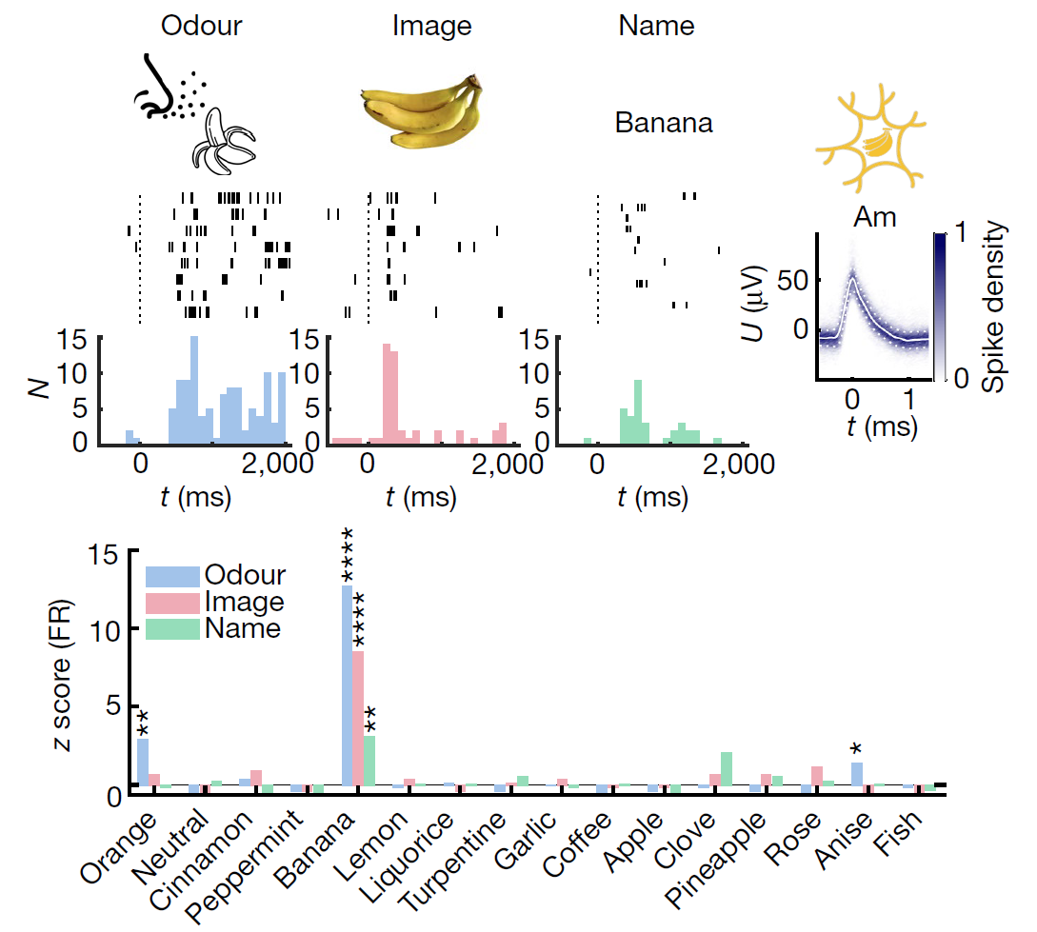
Multimodal Banana Cell (Am)

Slide 23
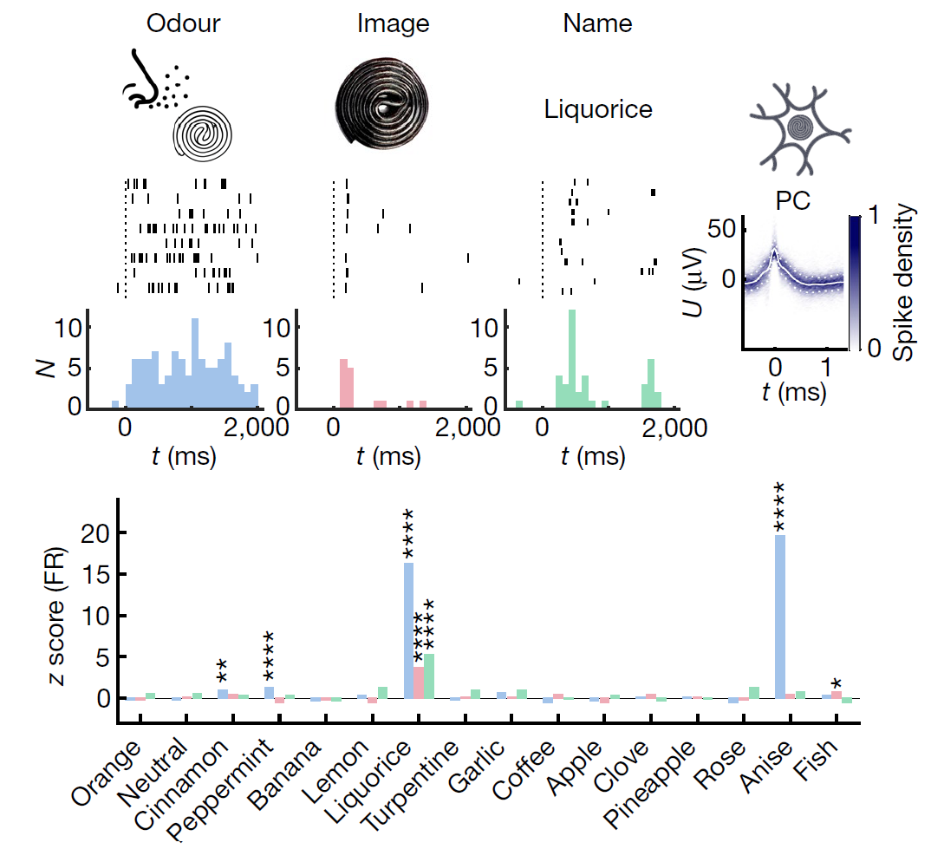
Multimodal Licorice Cell (PC)

Slide 24
Summary
Different regions in the olfactory network process differentiated aspects of the olfactory stimulus
(take from paper)

